Slide 1
A presentation on MULTIPLE DISEASE PREDICTION SYSTEM
GUIDE: ms. Shweta
assistant PROFEESOR
By : ANSHUL GAUTIYAL

Slide 2
CONTENT
OBJECTIVE
INTRODUCTION
ALGORITHMS
REQUIREMENT ANALYSIS
METHODOLOGY
ARCHITECTURE
RESULT
CONCLUSION
FUTURE SCOPE

Slide 3
OBJECTIVE
The objective of this model is to investigate how Machine Learning (ML) algorithms can enhance healthcare by enabling more precise and early detection of diseases. In order to achieve this, we will evaluate research studies that employ multiple supervised ML models for each disease recognition task. By using a variety of algorithms in our analysis, we can obtain more comprehensive and accurate results. This approach helps to mitigate biases that may arise from evaluating a single algorithm across different research scenarios, which can lead to misleading conclusions.

Slide 4
introduction
The project "Multiple Disease Prediction using Machine Learning and Streamlit" is centered around the prediction of three distinct diseases: diabetes, heart disease and Parkinson's disease. To achieve this, the project employs various machine learning algorithms tailored to each disease category. Specifically, Support Vector Machine (SVM) is utilized for diabetes and Parkinson's disease prediction, Logistic Regression for heart disease, and K-Nearest Neighbour (KNN) is used to store all the available data and classifies a new data point based upon the similarity.

Slide 5
Many of the existing machine learning models for health care analysis are concentrating on one disease per analysis. For example first is for liver analysis, one for diabetes analysis, one for jaundice diseases like that. If a user wants to predict more than one disease, he/she has to go through different sites. There is no common system where one analysis can perform more than one disease prediction. Some of the models have lower accuracy which can seriously affect patients’ health.
When an organization wants to analyze their patient’s health reports, they have to deploy many models which in turn increases the cost as well as time some of the existing systems consider very few parameters which can yield false results. The proposed system is a powerful disease prediction tool that enables users to predict a multiple disease at a one place with great accuracy and ease.

Slide 6
aLGORITHMS
1. LOGISTIC REGRESSION :
Logistic regression analysis studies the association between a categorical dependent variable and a set of independent (explanatory) variables. The name logistic regression is used when the dependent variable has only two values, such as 0 and 1 or Yes and No. The name multinomial logistic regression is usually reserved for the case when the dependent variable has three or more unique values, such as Married, Single, Divorced, or Widowed.

Slide 7
2. SUPPORT VECTOR MACHINE (SVM):
Support Vector Machine (SVM) is a supervised machine learning algorithm used for both classification and regression. Though we say regression problems as well it’s best suited for classification. The main objective of the SVM algorithm is to find the optimal hyperplane in an N-dimensional space that can separate the data points in different classes in the feature space. The hyperplane tries that the margin between the closest points of different classes should be as maximum as possible.
3. K-NEAREST NEIGHBOUR (KNN) :
K-Nearest Neighbour (KNN) is one of the simplest machine learning algorithms based on a supervised learning technique. KNN assumes a similarity between new data and existing data, categorizing new data into the most similar existing category. The algorithm stores all available data and classifies new data based on this similarity. When new data appears, KNN can classify it into an appropriate category using the existing data.

Slide 8
Requirement and analysis
Software Requirements:
Programming Languages : Python
Libraries and Frameworks:
▪ Pickle for machine learning algorithms.
▪ Pandas and NumPy for data manipulation and analysis.
▪ Matplotlib for data visualization.
▪ Streamlit for web application development.

Slide 9
3. Development Tools and IDEs: ▪ Google colab, Spyder, Anaconda or Visual Studio Code for code development and experimentation.
Hardware Requirements:
Processor (CPU): Multi-core processors ( Intel Core i5 or higher) for parallel processing and faster model training.
Memory (RAM): At least 8 GB of RAM for handling large datasets and complex machine learning models.
Sufficient disk space for storing datasets, software, and model artifacts.
SSD (Solid State Drive) (Size – 512GB) recommended for faster data access and Processing.
Network Connectivity: Stable internet connection for accessing online resources, downloading datasets.

Slide 10
methodology
1. Data Collection: Data is gathered from Kaggle.com, a well-known platform recognized for its extensive collection of datasets. The data is obtained specifically for diabetes, heart disease and Parkinson's disease.

Slide 11
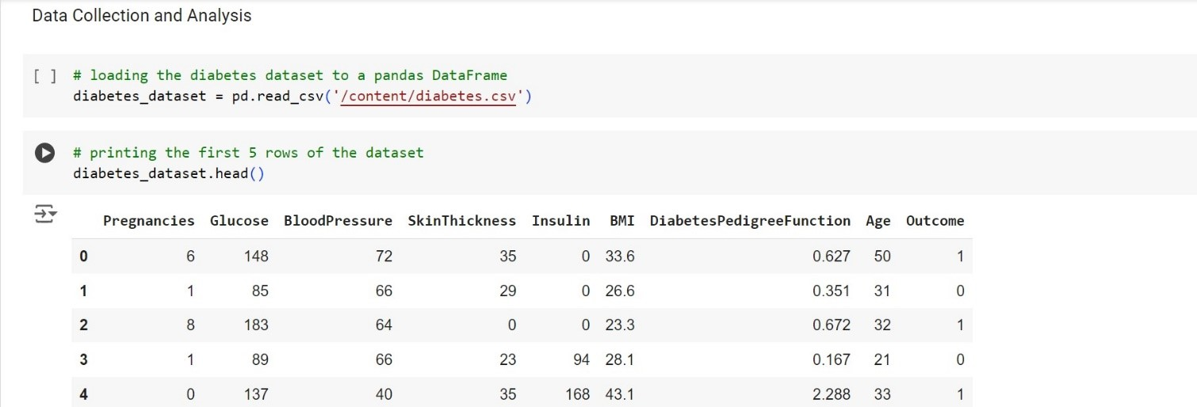

Slide 12
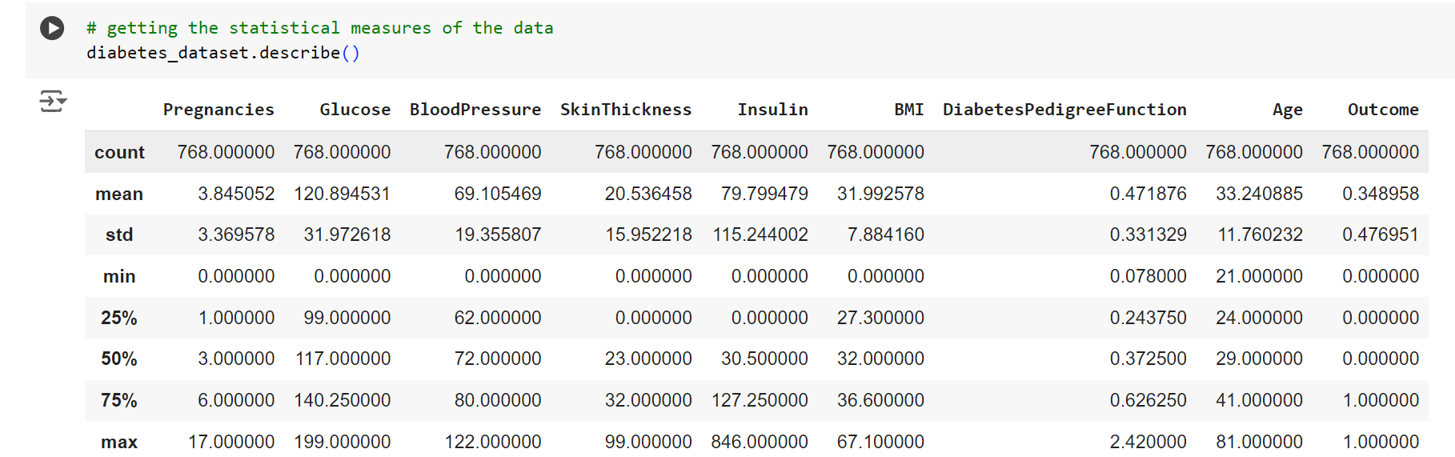
2. Data Preprocessing: To ensure the quality and suitability of the collected data for training machine learning models, several preprocessing steps are undertaken. These include addressing missing values, eliminating duplicates, and applying techniques such as data normalization or feature scaling.

Slide 13
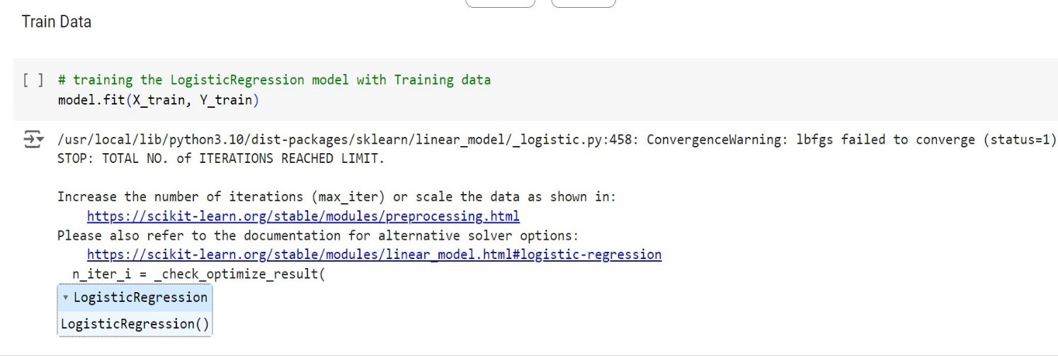
3. Model Selection: For each disease prediction task, different machine learning algorithms are carefully chosen. Support Vector Machine (SVM), Logistic Regression, and K- Nearest Neighbour (KNN)are selected based on their performance and appropriateness for the specific prediction tasks.
4. Training and Testing: The preprocessed data is divided into training and testing sets. Subsequently, the models are trained using the training data, and their performance is assessed using the testing data. The evaluation metric used to gauge the performance of each model is accuracy.

Slide 14
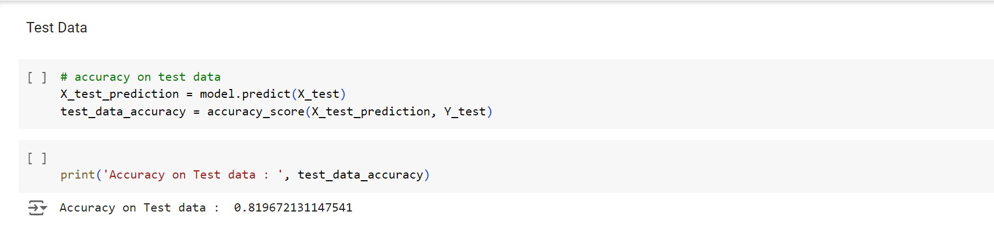
5. Model Deployment: Utilizing Streamlit, along with its cloud deployment functionalities, an interactive web application is developed. This application provides users with a straightforward interface offering prediction options for three diseases: heart disease, diabetes and Parkinson's disease. Upon selecting a specific disease, the user is prompted to input the requisite parameters for the prediction.

Slide 15
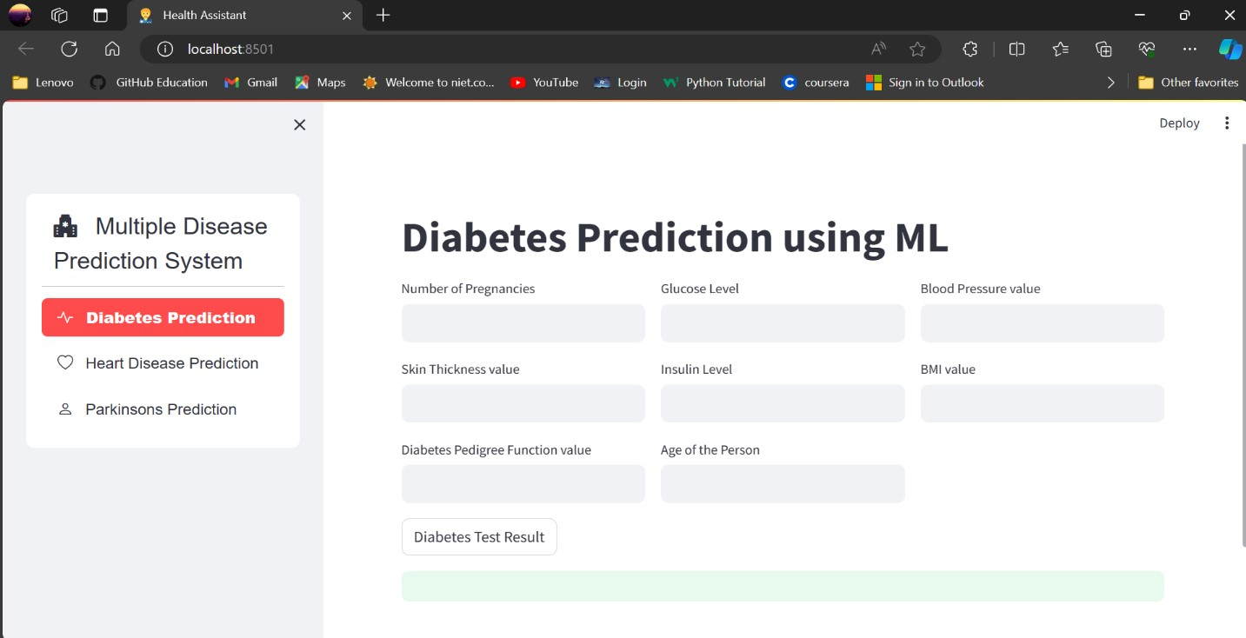

Slide 16
architecture
It starts with data collection, gathering user information such as medical history, lifestyle factors, demographics, and biomarkers. Subsequently, the collected data undergoes preprocessing to ensure its suitability for analysis, which may involve data cleaning, addressing missing values, and normalizing the data. Following preprocessing, feature selection is conducted to identify the most significant features pertinent to disease prediction. This step aids in reducing data dimensionality and enhancing prediction accuracy . Next, an appropriate model is chosen for disease prediction, which may involve selecting a suitable machine learning algorithm, KNN or naïve baiyes based on the nature of data and disease.

Slide 17
Once the model is chosen, it undergoes training using the collected data to discern patterns and correlations between features and the predicted disease. Subsequently, model evaluation is conducted to assess the accuracy and generalization capability of the trained model on an independent dataset. Finally, the trained model is utilized to predict the likelihood of an individual developing the targeted disease. In summary, the disease prediction process necessitates expertise in data science, machine learning, and domain-specific medical knowledge to ensure accurate predictions.

Slide 18
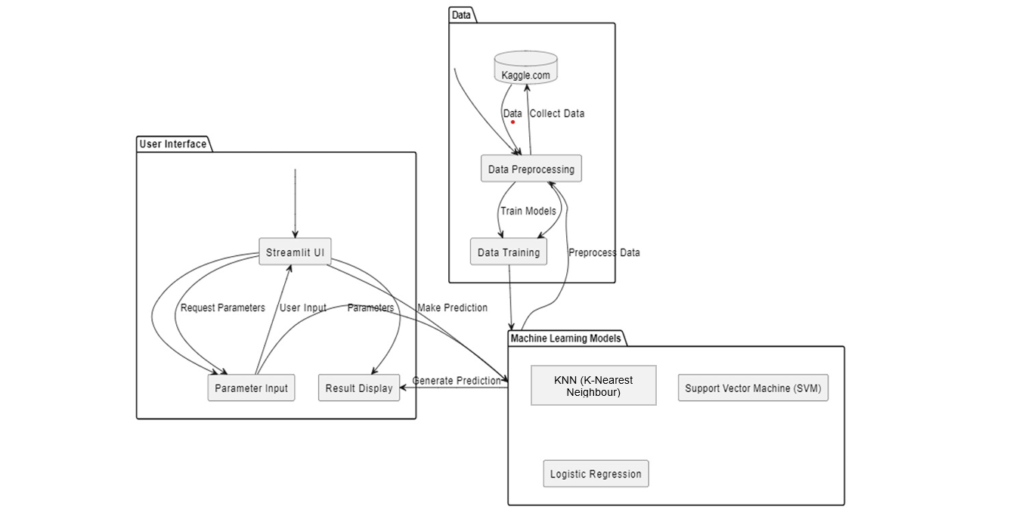

Slide 19
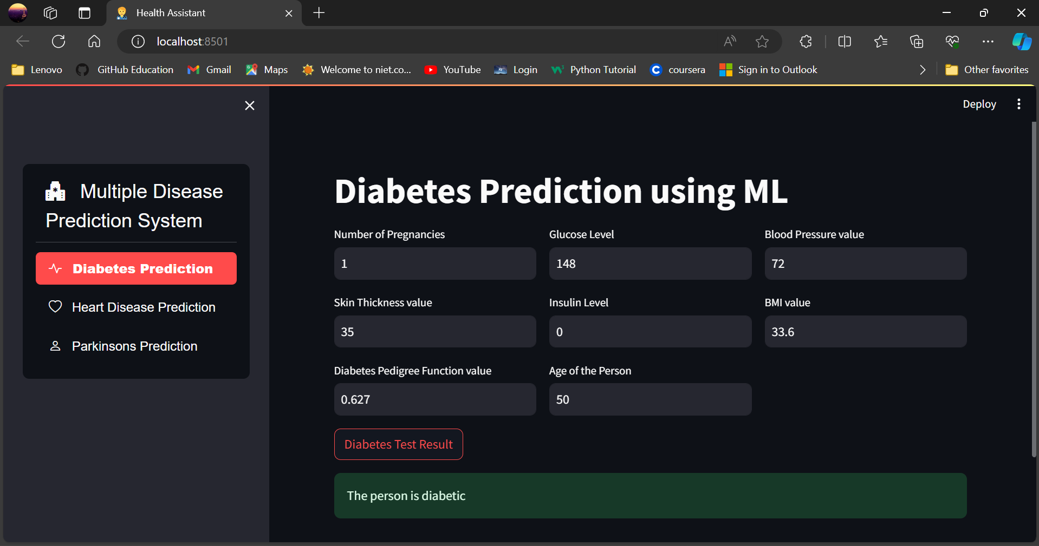
RESULT

Slide 20
conclusion
Our project employed various machine learning algorithms, such as Support Vector Machine (SVM), Logistic Regression, and KNN, to construct a disease prediction system focusing on three ailments: diabetes, heart disease and Parkinson's disease. Data was sourced from Kaggle.com and underwent preprocessing to ensure its quality. Our SVM model achieved a 78% accuracy rate for diabetes prediction and an 89% accuracy rate for Parkinson's disease prediction. Logistic Regression yielded an 85% accuracy rate for heart disease prediction.

Slide 21
The system is designed with user-friendliness in mind, offering a menu for selecting diseases and prompting users to input relevant parameters for prediction. Once parameters are provided, the system displays the predicted disease result. While the obtained accuracy rates demonstrate the effectiveness of our machine learning models, it's essential to acknowledge that these values may vary depending on dataset specifics and model training processes.

Slide 22
Future scope
1. Expansion of Disease Prediction: The current project focuses on diabetes, heart disease and Parkinson's disease. In the future, additional diseases can be included to create a more comprehensive and diverse disease prediction system.
2. Integration of More Machine Learning Algorithms: While the project already employs Support Vector Machines (SVM), Logistic Regression, there are many other machine learning algorithms that can be explored. Incorporating algorithms such as Random Forest, Gradient Boosting, or Neural Networks may further improve the accuracy and performance of the disease prediction models.

Slide 23
3. Real-time Monitoring and Feedback: improving the application to offer continuous monitoring and personalized feedback can be advantageous. This could involve implementing features like reminders for routine health check-ups, tailored suggestions for disease prevention, or notifications for irregular health indicators.

Slide 24
THANK YOU

